Slide 1
Software Architecture
Modeling Tools and
Languages

Slide 2








4+1 View Model of Architecture
End user
Development view
Programmers & software managers
Logical view
Scenarios
Process View
Physical View
Integrator
System Engineer
Software Systems Architecture
Xiaobin Xu
7

Slide 3
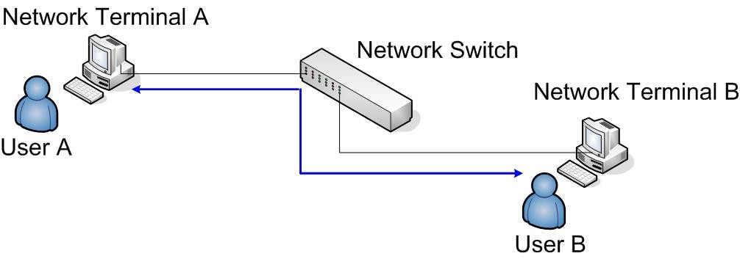
“4+1 Views” Model
A Case: Software Architecture of a Network Application System -
--- NAS
Requirements:
Terminals receive the input data from users.
Terminal A formats the input data, and sends the formatted data to Terminal B by network.
Terminal B parses the formatted data, and represent them to users in the screen.
Software Systems Architecture Xiaobin Xu 8

Slide 4
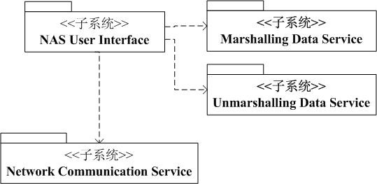
“4+1 Views” Model
Logic View
The functional abstraction of system. It mainly focused on dividing the System into several functional components and describe their functional relationships.
Software Systems Architecture
Xiaobin Xu
9

Slide 5
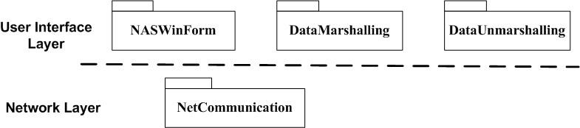
“4+1 Views” Model
Development View
The detailed design and construction abstraction of system. It mainly gives a general structure of system for the detailed design and construction.
Software Systems Architecture
Xiaobin Xu
10

Slide 6
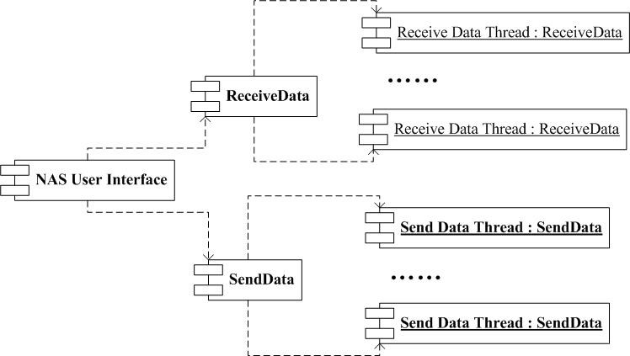
“4+1 Views” Model
Process View
It mainly for the non-functional properties and the runtime characters of system.
Software Systems Architecture
Xiaobin Xu
11

Slide 7
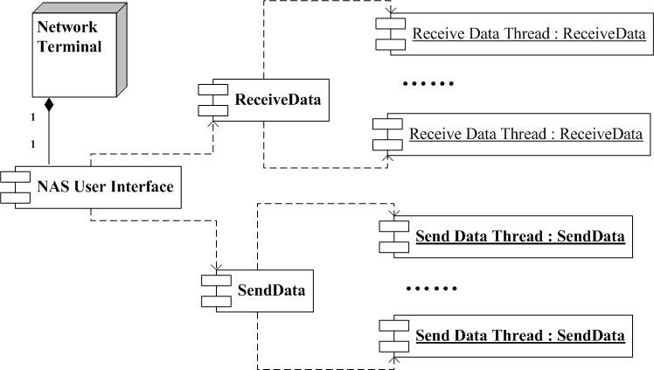
“4+1 Views” Model
Physical View
The mapping relationship to the physical deployment environments of system.
12
Software Systems Architecture Xiaobin Xu

Slide 8
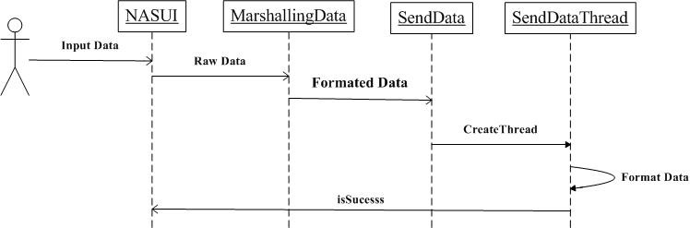
“4+1 Views” Model
It is for describing the important system use cases.
Scenarios View
Software Systems Architecture
Xiaobin Xu
13

Slide 9
Rational’s 4+1 View Model
Design View
Implementation View
End-user
Programmers
Software management
Functionality
Use Case View
Interaction View
System integrators Performance Scalability Throughput
Deployment View
System engineering System topology Delivery, installation Communication
Software Systems Architecture
Xiaobin Xu
14

Slide 10
Rational’s 4+1 View Model
Simplified models to fit the context
Not all systems require all views:
Single processor: drop deployment view
Single process: drop process view
Very Small program: drop implementation view
Adding views:
Data view, security view
Software Systems Architecture
Xiaobin Xu
15

Slide 11
Rational’s 4+1 View Model
Use Case View/Scenarios
The use case view of a system encompasses the use cases that describe the behaviour of the system as seen by its end users, analysts, and testers.
The view exists to specify the forces that shape the system’s architecture.
With UML:
the static aspects of this view are captured in use case diagrams.
the dynamic aspects of this view are captured in interaction diagrams, state diagrams, and activity diagrams.
Software Systems Architecture
Xiaobin Xu
16

Slide 12
Rational’s 4+1 View Model
Design View/Logic View
The design view of a system encompasses the classes, interfaces, and collaborations that form the vocabulary of the problem and its solution.
The view primarily supports the functional requirements of the system, meaning the services that the system should provide to its end users.
With UML:
the static aspects of this view are captured in class diagrams and object diagrams.
the dynamic aspects of this view are captured in interaction diagrams, state diagrams, and activity diagrams.
Software Systems Architecture
Xiaobin Xu
17

Slide 13
Rational’s 4+1 View Model
Interaction View/Process View
The interaction view of a system shows the flow of control among its various parts, including possible concurrency and synchronization mechanisms.
The view primarily addresses the performance, scalability, and throughput of the system.
With UML, the static and dynamic aspects of this view are captured in the same kinds of diagrams as the design view but with a focus on the active classes that control the system and the message that flow between them.
Software Systems Architecture
Xiaobin Xu
18

Slide 14
Rational’s 4+1 View Model
Implementation View/Development View
The implementation view of a system encompasses the artifacts that are used to assemble and release the physical system.
The view primarily addresses the configuration management of the system's releases, made up of somewhat independent components that can be assembled in various ways to produce a running system.
With UML:
the static aspects of this view are captured in artifact diagrams.
the dynamic aspects of this view are captured in interaction diagrams, state diagrams, and activity diagrams.
Software Systems Architecture
Xiaobin Xu
19

Slide 15
Rational’s 4+1 View Model
Deployment View/Physical View
The deployment view of a system encompasses the nodes that form the system's hardware topology, upon which the system executes.
The view primarily addresses the distribution, delivery, and installation of the parts that make up the physical system.
With UML:
the static aspects of this view are captured in deployment diagrams.
the dynamic aspects of this view are captured in interaction diagrams, statechart diagrams, and activity diagrams.
Software Systems Architecture
Xiaobin Xu
20

Slide 16
Modeling Tools and Languages
Object-oriented modeling languages
Object-oriented modeling languages started to appear sometime between the mid-1970s and the late 1980s as methodologists
The number of object-oriented models methods increased from less than 10 to
more than 50 during the period between 1989 and 1994.
Grady Booch's Booch method ---Rational Software Corporation)
Ivar Jacobson's Object-Oriented Software Engineering (OOSE) ---Objectory
James Rumbaugh's Object Modeling Technique (OMT) --- General Electric
In simple terms:
The Booch method was particularly expressive during the design and construction phases of projects.
OOSE provided excellent support for business engineering and requirements analysis.
OMT-2 was expressive for analysis of data-intensive information systems.
Software Systems Architecture Xiaobin Xu
22

Slide 17

Overview of the UML
The UML is a language for
visualizing
specifying
constructing
documenting
the artifacts of a software-intensive system
Software Systems Architecture
Xiaobin Xu
23

Slide 18
Overview of the UML
Modeling elements
Relationships
Extensibility Mechanisms
Diagrams
Software Systems Architecture
Xiaobin Xu
24

Slide 19
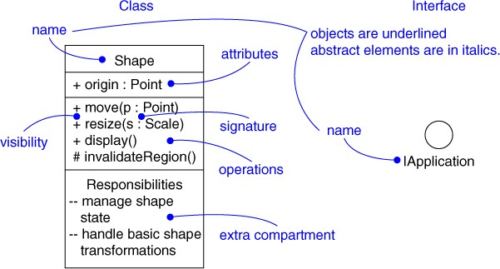
Modeling Elements
Structural elements
class, interface, collaboration, use case, active class, component, node
Behavioral elements
interaction, state machine
Grouping elements
package, subsystem
Other elements
note
Software Systems Architecture
Xiaobin Xu
25

Slide 20
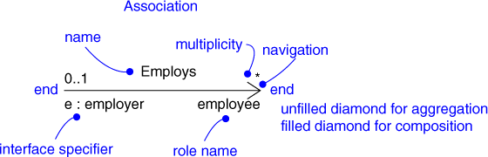
Relationships
Dependency
Association
Generalization
Realization
Software Systems Architecture
Xiaobin Xu
26

Slide 21
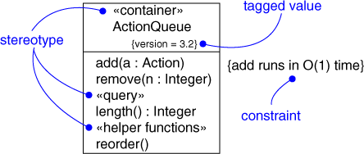
Extensibility Mechanisms
Stereotype
Tagged value
Constraint
Software Systems Architecture
Xiaobin Xu
27

Slide 22
Models, Views, and Diagrams
A model is a complete
description of a system from a particular perspective
State Diagrams
Class Diagrams
State Diagrams
Use Case Diagrams
Use Case Diagrams
Use Case Diagrams
State Diagrams
Object Diagrams
Use Case Diagrams
State Diagrams
Sequence Diagrams
Use Case Diagrams
Scenario Diagrams
State Diagrams
Componen Diagrams
Scenario Diagrams
State Diagrams
t
Collaboration Diagrams
Models
Scenario Diagrams
Component Diagrams
Statechart Diagrams
Deploymen Diagrams
Scenario Diagrams
Component Diagrams
t
Activity Diagrams
Software Systems Architecture
Xiaobin Xu
28

Slide 23
Diagrams
A diagram is a view into a model
Presented from the aspect of a particular stakeholder
Provides a partial representation of the system
Is semantically consistent with other views
In the UML, there are 13 standard diagrams
Static views: use case, class, object, component, deployment, package, composite structure
Dynamic views: sequence, communication, state
machine, activity, timing, interaction overview
Software Systems Architecture Xiaobin Xu
29

Slide 24
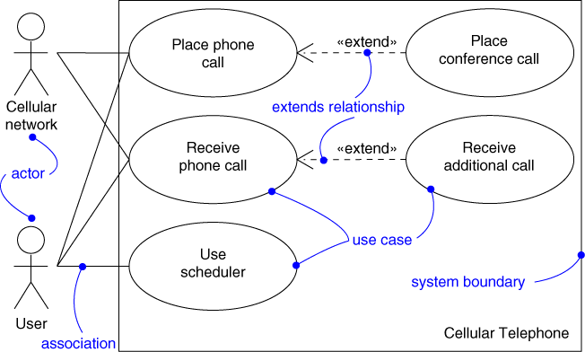
Use Case Diagram
Captures system functionality as seen by users
Software Systems Architecture
Zhenyan Ji
30

Slide 25
Use Case Diagram
Captures system functionality as seen by
users
Built in early stages of development
Purpose
Specify the context of a system
Capture the requirements of a system
Validate a system’s architecture
Drive implementation and generate test cases
Developed by analysts and domain experts
Software Systems Architecture Xiaobin Xu
31

Slide 26
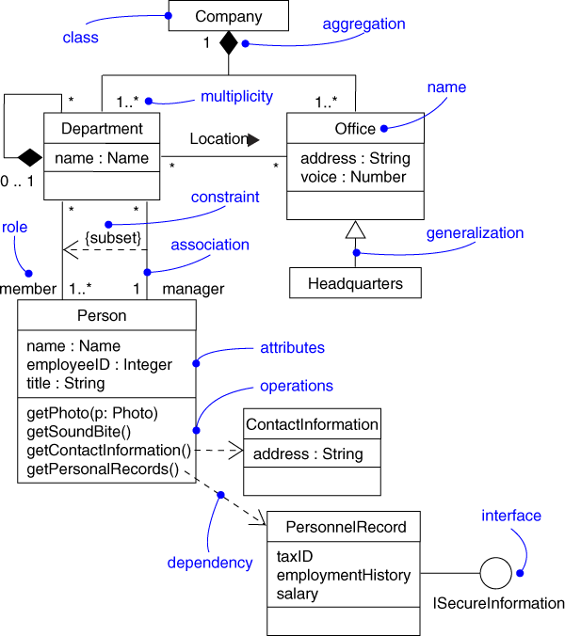
Class Diagram
Captures the vocabulary of a system
Software Systems Architecture
Xiaobin Xu
32

Slide 27
Class Diagram
Captures the vocabulary of a system
Built and refined throughout development
Purpose
Name and model concepts in the system
Specify collaborations
Specify logical database schemas
Developed by analysts, designers, and implementers
Software Systems Architecture
Xiaobin Xu
33

Slide 28
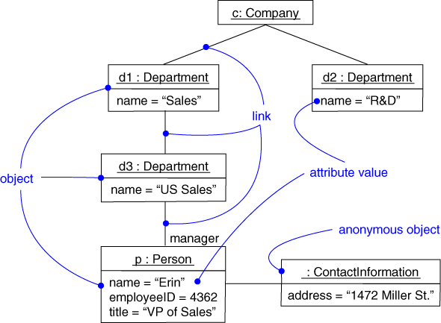
Object Diagram
Captures instances and links
Software Systems Architecture
Xiaobin Xu
34

Slide 29
Object Diagram
Shows instances and links
Built during analysis and design
Purpose
illustrate data/object structures
Specify snapshots
Developed by analysts, designers, and implementers
Software Systems Architecture
Xiaobin Xu
35

Slide 30
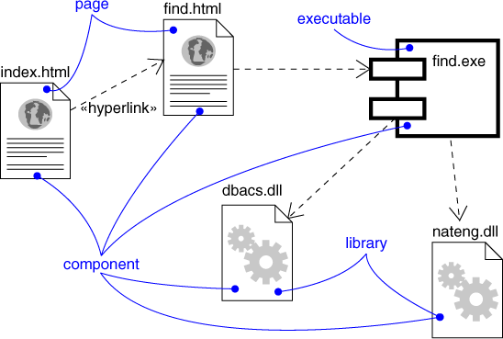
Component Diagram
Captures the physical structure of the implementation
Software Systems Architecture
Xiaobin Xu
36

Slide 31
Component Diagram
Captures the physical structure of the
implementation
Built as part of architectural specification
Purpose
Organize source code
Construct an executable release
Specify a physical database
Developed by architects and programmers
Software Systems Architecture
Xiaobin Xu
37

Slide 32
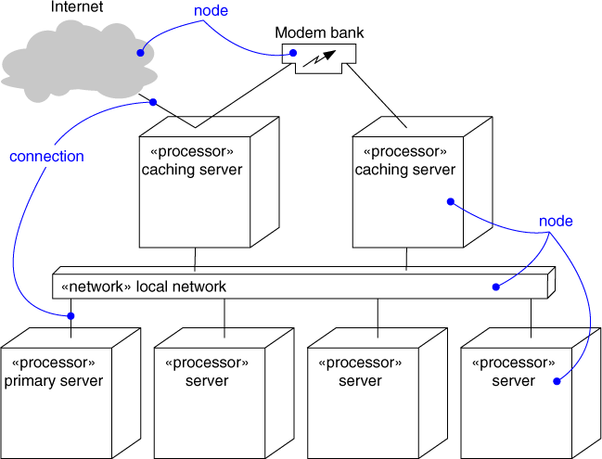
Deployment Diagram
Captures the topology of a system’s hardware
Software Systems Architecture
Xiaobin Xu
38

Slide 33
Deployment Diagram
Captures the topology of a system’s
hardware
Built as part of architectural specification
Purpose
Specify the distribution of components
Identify performance bottlenecks
Developed by architects, networking engineers, and system engineers
Software Systems Architecture
Xiaobin Xu
39

Slide 34
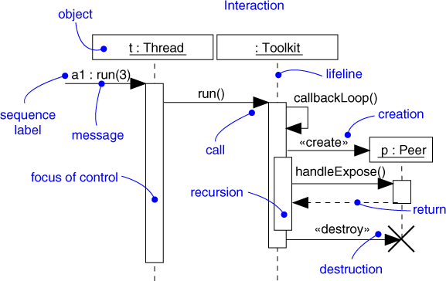
Sequence Diagram
Captures dynamic behavior (time-oriented)
Software Systems Architecture
Xiaobin Xu
40

Slide 35
Sequence Diagram
Captures dynamic behavior (time-oriented)
Purpose
Model flow of control
Illustrate typical scenarios
Software Systems Architecture
Xiaobin Xu
41

Slide 36
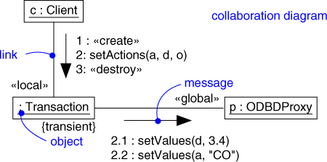
Communication Diagram
Captures dynamic behavior (message- oriented)
Software Systems Architecture
Xiaobin Xu
42

Slide 37
Communication Diagram
Captures dynamic behavior (message-
oriented)
Purpose
Model flow of control
Illustrate coordination of object structure and control
Software Systems Architecture
Xiaobin Xu
43

Slide 38
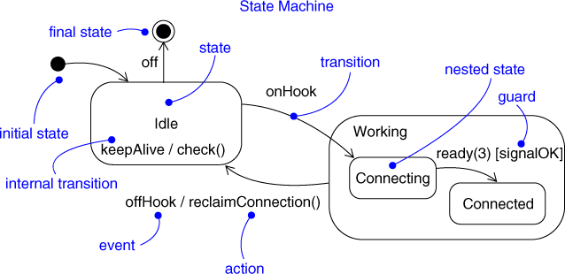
State Diagram
Captures dynamic behavior (event-oriented)
Software Systems Architecture
Xiaobin Xu
44

Slide 39



State Diagram
Captures dynamic behavior (event-oriented)
Purpose
Model object lifecycle
Model reactive objects (user interfaces, devices, etc.)
Software Systems Architecture
Xiaobin Xu
45

Slide 40
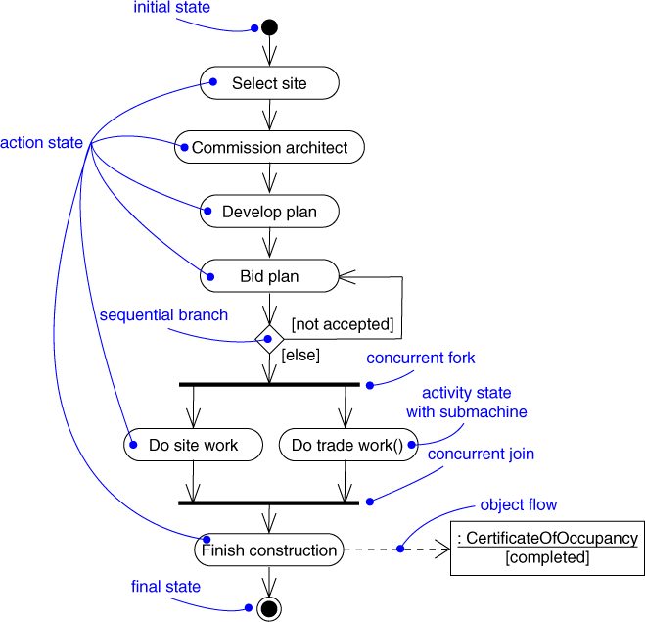
Activity Diagram
Captures dynamic behavior (activity-oriented)
Software Systems Architecture
Xiaobin Xu
46

Slide 41
Activity Diagram
Captures dynamic behavior (activity-oriented)
Purpose
Model business workflows
Model operations
Software Systems Architecture
Xiaobin Xu
47

